Slide 1
Lesson 2: How To Treat Others
The Person
God Expects

Slide 2
Review
Christians are to grow into perfection, maturity in Christ
Christians are to renew their minds
Christians are to
Put off the old man
Grows corrupt
Put on the new man
Created in righteousness & holiness

Slide 3
Ephesians 4:25
Put Off
Put On
Lying
Speaking the truth
For we are members of one another
Of the Body of Christ (Eph 5:30)
Of the House of God (Eph 2:19)

Slide 4
Ephesians 4:26-27
Put Off
Put On
Lying
Wrath/resentment
Speaking the truth
Self Control/joy
Gives the Devil an opportunity

Slide 5
Ephesians 4:28
Put Off
Put On
Lying
Wrath/resentment
Stealing
Speaking the truth
Self Control/joy
Working & Giving
It’s good
Be able to give those who are in need

Slide 6
Ephesians 4:25
Put Off
Put On
Lying
Wrath/resentment
Stealing
Corrupt Speech
Speaking the truth
Self Control/joy
Working & Giving
Edifying Speech
Give grace to those who hear
You have the Holy Spirit (Eph 1:13-14; 2:22)

Slide 7
Ephesians 4:25
Put Off
Put On
Lying
Wrath/resentment
Stealing
Corrupt Speech
Malice
Speaking the truth
Self Control/joy
Working & Giving
Edifying Speech
Love
God forgave us
Jesus loved us and gave Himself for us
Notes:
Malice = ill will towards others
Love = agape…affection, good will, benevolence

Slide 8
Put Off: Malice
Bitterness
Wrath
Anger
Notes:
Next slides will define wrath and anger

Slide 9
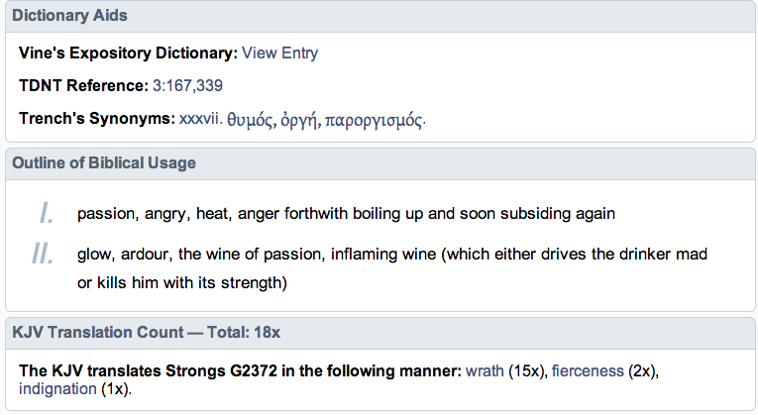
Wrath
Notes:
Wrat

Slide 10
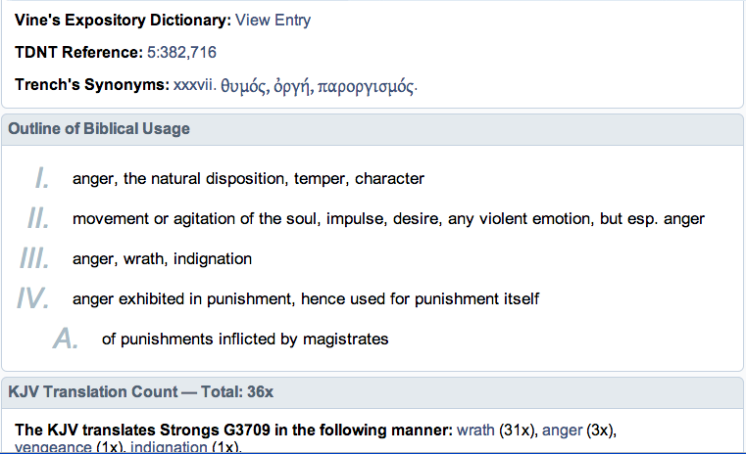
Anger

Slide 11
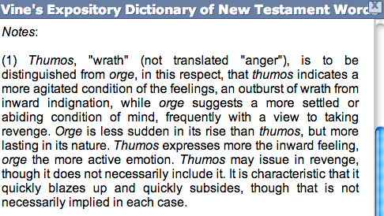
Wrath vs Anger

Slide 12
Put Off: Malice
Bitterness
Wrath
Anger
Clamor
Evil Speaking
Notes:
Clamor= crying, outcry…I suppose it’s like Php 2 do all things without grumbling or complaining
Evil speaking = blaspheme…speak against

Slide 13
Put On: Love
Kindness
Tender-hearted
Forgiving
Notes:
Kindness = mild, pleasant, (opposite of harsh)
Tender-hearted = compassionate

Slide 14
Why Would Paul Write These Things To Christians?
25 Therefore, putting away lying, "Let each one of you speak truth with his neighbor," for we are members of one another…. 31 Let all bitterness, wrath, anger, clamor, and evil speaking be put away from you, with all malice. 32 And be kind to one another, tenderhearted, forgiving one another, even as God in Christ forgave you. 1 Therefore be imitators of God as dear children. 2 And walk in love, as Christ also has loved us and given Himself for us, an offering and a sacrifice to God for a sweet-smelling aroma.
Problems with one another

Slide 15
Which of these do I struggle with?
Why is it hard for me put off the old and put on the new?
What questions should I ask myself?

